Slide 1

Cerebrio
AI-Powered Real-Time Communication

Slide 2
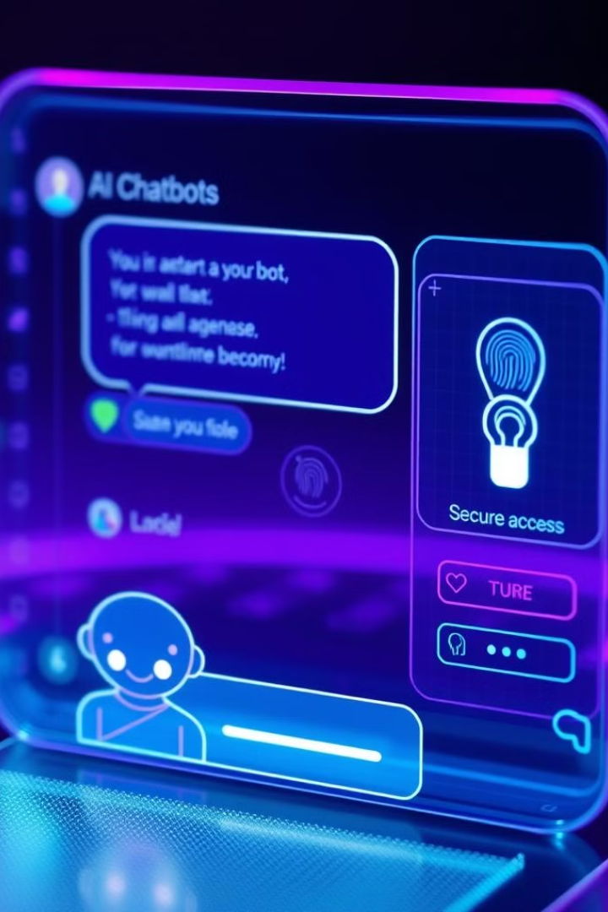
Introduction
Cerebrio is a real-time messaging application integrated with an AI-powered chatbot, designed to revolutionize user interaction. Inspired by the UN's Sustainable Development Goal for Innovation and Infrastructure (SDG 9), Cerebrio combines React, Node.js, and AI to deliver an advanced messaging solution.
The platform includes user registration, authentication, and a chat interface, suitable for personal, professional, and educational use. Cerebrio offers instant notifications, a seamless messaging experience, and AI-driven solutions for user-specific tasks, aiming to improve productivity and simplify tasks through its dual capabilities.

Slide 3
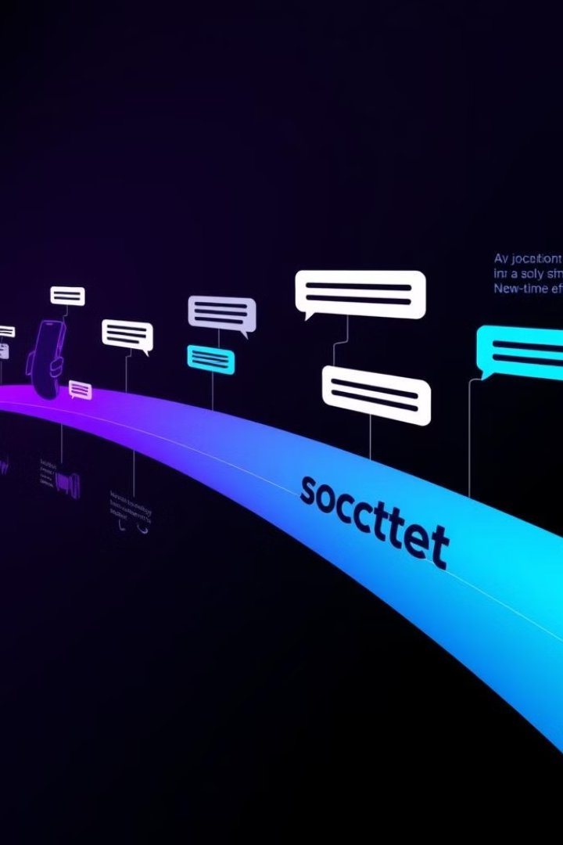
Literature Review: Real-Time Messaging Evolution
Historical Context
Key Research
From early chat rooms like IRC to today's popular apps like WhatsApp and Slack, real-time messaging has evolved significantly.
WebSockets , standardized by IETF RFC 6455, enable real-time communication, making interactive messaging possible.

Slide 4



Objectives and Key Features
Cerebrio aims to provide a robust, user-centric platform that enhances communication and problem-solving with AI assistance. Specific goals include facilitating seamless real-time messaging, incorporating an AI chatbot for contextual responses, ensuring data security, and promoting innovation in alignment with SDG 9.
Key features include real-time messaging with delivery status, an AI-powered chatbot for query resolution, secure user authentication, chat management, responsive design, scalable infrastructure, end-to-end encryption, and customization options. These features make Cerebrio an all-in-one solution for communication and intelligent task management.
Real-Time Messaging
AI-Powered Chatbot
User Authentication
Instant communication with delivery status updates and notifications.
A smart assistant capable of generating responses and performing tasks.
Secure login and registration with role-based access control.

Slide 5

Project Scope and Target Audience
Cerebrio scope includes real-time messaging, AI chatbot integration, user and admin modules, and backend features like secure APIs and database management. Exclusions are third-party integrations and offline messaging. The target audience includes businesses, educational institutions, and individuals seeking communication and AI solutions.
Future possibilities include voice-to-text, multilingual support, and real-time analytics. Cerebrio caters to businesses, educational institutions, and individuals seeking a blend of communication and AI-driven solutions. The project lays the groundwork for further development, such as integrating voice-to-text capabilities and real-time analytics.
1
Inclusions
2
Exclusions
3
Target Audience
Real-time messaging and AI chatbot integration.
Third-party integrations and offline messaging.
Businesses, educational institutions, and individuals.

Slide 6





Technology Stack
MERN Stack
React.js
Node.js & Express.js
MongoDB
Web Sockets
Responsive and dynamic user interface.
Fast and scalable server-side operations.
Flexible and efficient data storage.
​Socket.io ​for real-time bidirectional communication)
Tailwind CSS
for responsive design

Slide 7



Functional Requirements
The User Module provides an interactive communication experience with real-time messaging, chat history management, file sharing, AI chatbot support, and customizable user profiles. The Administrator Module empowers admins to manage users, monitor activity, and ensure smooth platform operation with user management, content moderation, and system analytics.
Admins can activate/deactivate user accounts, manage roles, and set user-specific preferences. AI-based filtering ensures inappropriate content is flagged, allowing admins to delete messages or block users. A real-time dashboard provides insights into system performance, user activity, and server health.
Real-Time Messaging
File Sharing
AI Chatbot Support
Immediate message delivery via WebSocket technology.
Secure upload and download of images and documents.
Instant assistance for common queries and automated tasks.

Slide 8




Hardware Requirement
Processor :
Hard Disk:
RAM:
Intel core i3 or above for a stable experience and fast retrieval of data.
40GB and above
256 MB or more, recommended 2 GB for fast reading and writing capabilities which will result in better performance time.

Slide 9
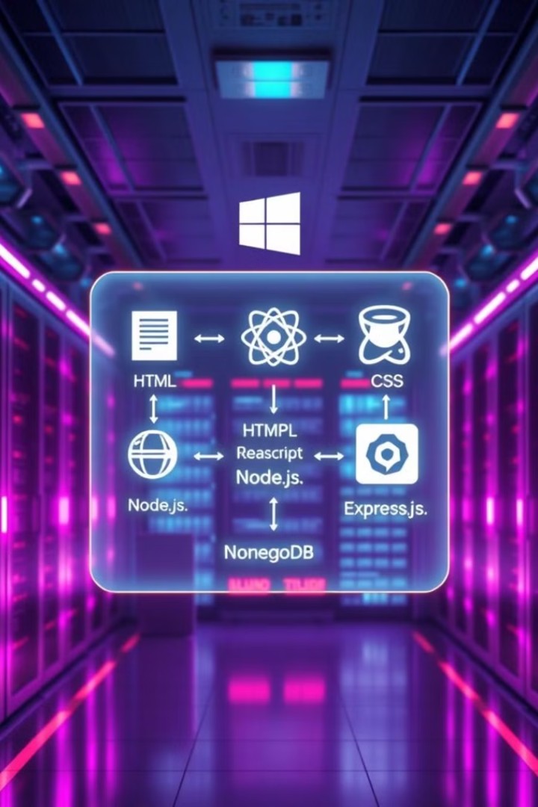
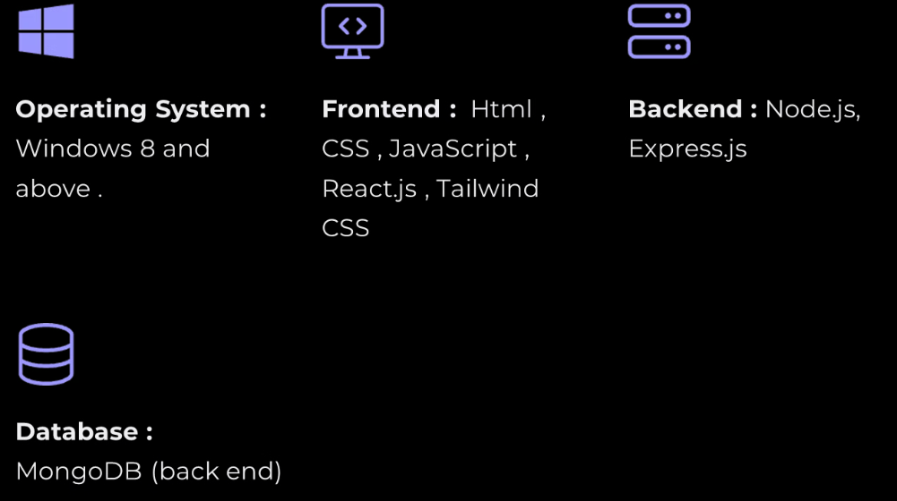
Software Requirement

Slide 10

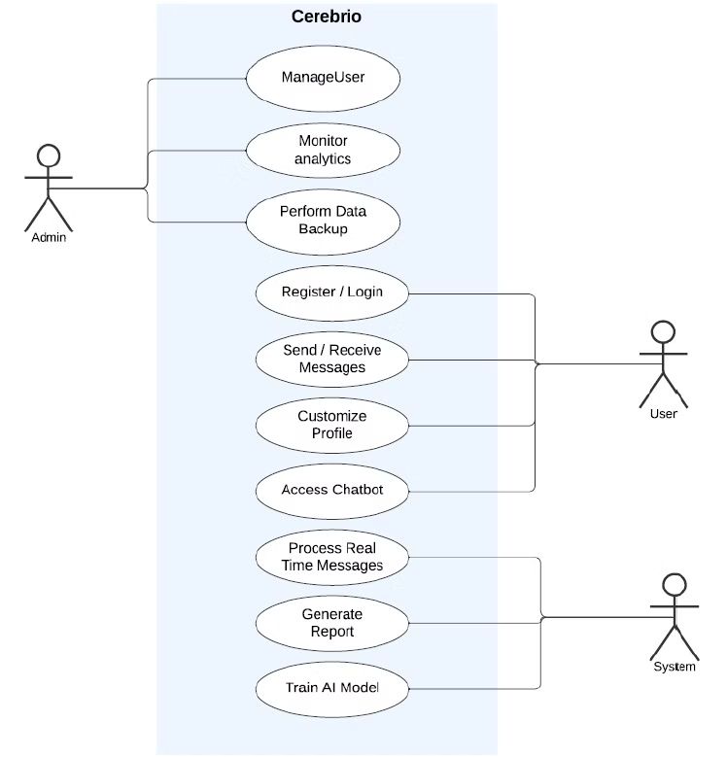
Use Case Diagram
Use Case Diagram A Use Case Diagram is a type of visual representation in the Unified Modeling Language (UML) that depicts the functional requirements of a system from the user's perspective. It helps identify the system's interactions with users and the specific tasks or processes that the system supports.

Slide 11

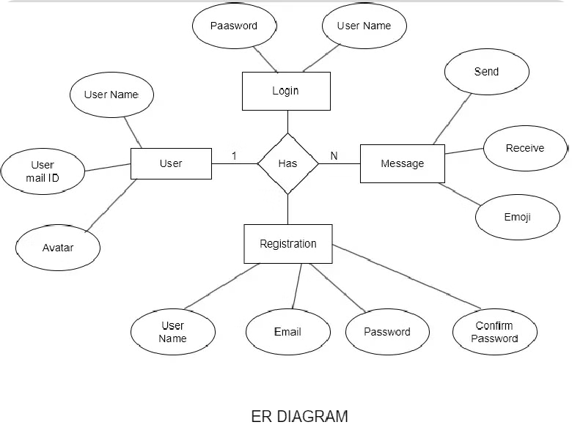
ER-Diagram
An Entity-Relationship (ER) Diagram is a graphical representation used in database design to illustrate the structure of a system and the relationships between entities within it.

Slide 12
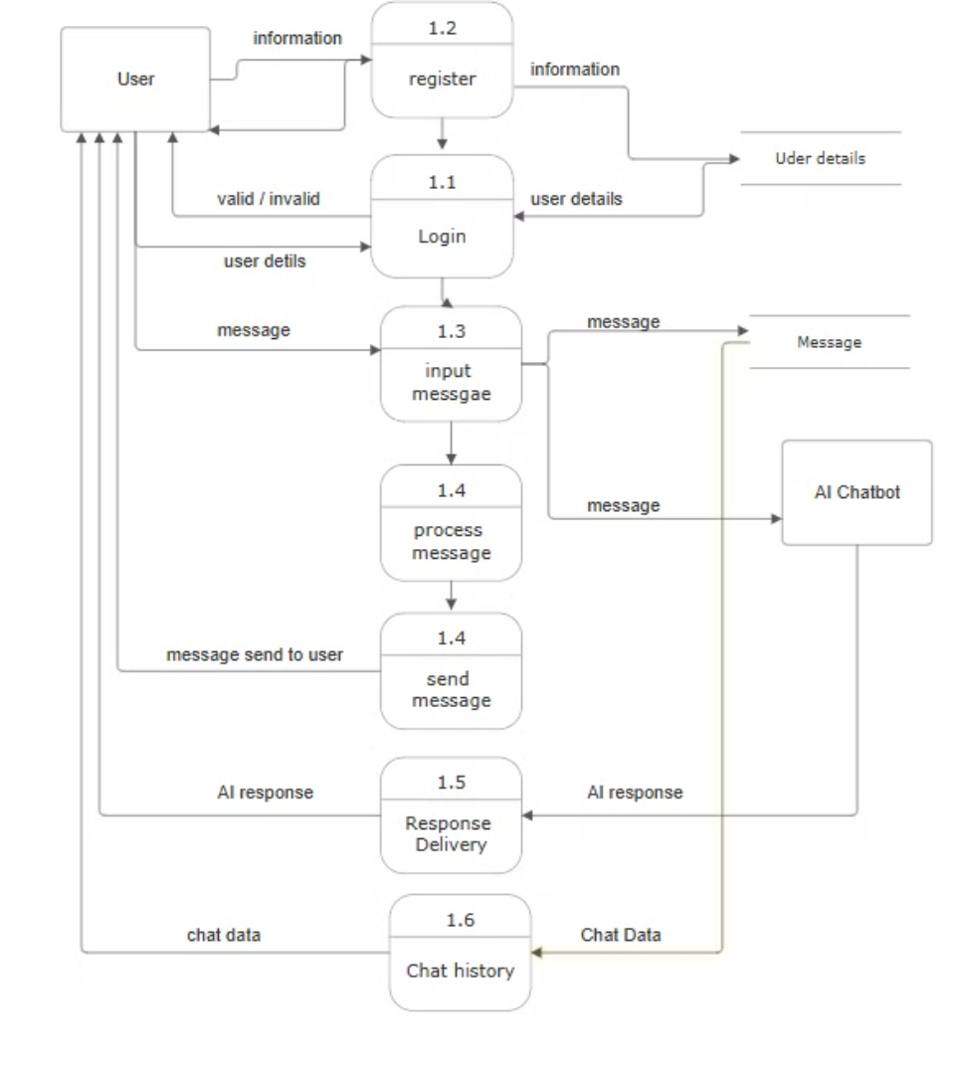
Data Flow Diagram
A Data Flow Diagram (DFD) is a graphical representation of how data moves through a system, depicting the input, processing, storage, and output of data. It helps in understanding system functionality and data movement without focusing on technical implementation details. It shows how the main system functions interact and exchange data internally while continuing to interact with external entities.

Slide 13





Modules: Core Functionality
Instant Messaging
Real-time text, audio, and video communication for seamless and engaging interactions.
Secure Authentication
User registration, login, and access control (JWT) for secure and reliable user authentication.
AI Chatbot
Natural language processing for intelligent responses and task automation, enhancing user experience . Media Sharing
Media Sharing
Upload, store, and share images, videos, and files via Cloudinary for rich media sharing.

Slide 14






Work Flow
User Authentication & Authorization
Chat Interface
Sending & Receiving Messages
Voice Typing ,File Sharing
AI Integrated Chatbot
Logout

Slide 15

Conclusion
CEREBRIO, the web-based chat application with AI-integrated chatbot functionality, revolutionizes digital communication by delivering intelligent, real-time, and personalized interactions. Powered by advanced AI technologies, it offers features like automated responses and user behavior insights, making it an efficient tool for customer service and collaboration.
With robust security measures and compliance with data privacy standards, CEREBRIO ensures trust and reliability. Its innovative AI-driven capabilities position it as a scalable and user-friendly solution for modern communication needs, fostering engagement and productivity across diverse applications.

Slide 16
THANK YOU

